Slide 1
Therapeutic Anticoagulation with heparin in critically ill patients with covid-19
Dr S Sidharth
PG Resident of Medicine
Lady Hardinge Medical College

Slide 2
WHY THIS TOPIC?
LIGHT AT THE END OF TUNNEL OR LULL BEFORE A STORM??
COVID-19- severe inflammation with risk of thrombosis
Meta-analysis of 66 studies showed the incidence of VTE to be 22.7%1.
As possibility of 3rd wave exists
We are reviewing course of anticoagulation in critically ill patients.
Res Pract Thromb Haemost 2020;4: 1178-91.

Slide 3
N Engl J Med 2021;385:777-89

Slide 4
AIM
To determine whether therapeutic dose anticoagulation with UFH/LMWH improves in-hospital survival, reduces duration of ICU level respiratory & cardiovascular organ support in critically ill covid-19.

Slide 5
METHODS
Data from 3 international trials harmonized in to one integrated, multiplatform RCT with aim to generate evidence for therapeutic anticoagulation in critically ill covid-19.
REMAP-CAP (Randomized, Embedded, Multifactorial Adaptive Platform Trial for Community-Acquired Pneumonia).
ACTIV-4a (Multi-center, Adaptive, Randomized Controlled Platform Trial of the Safety and Efficacy of Antithrombotic Strategies in Hospitalized Adults with COVID-19).
ATTACC trial (Antithrombotic Therapy to Ameliorate Complications of COVID-19).

Slide 6
INCLUSION
Severe COVID-19 was defined as: (n=1098)
Receipt of ICU-level respiratory (oxygen through a high- flow nasal cannula, non invasive or invasive mechanical ventilation, extracorporeal life support) or
Cardiovascular organ support (vasopressors, or inotropes).

Slide 7
EXCLUSION
Admitted to the ICU with COVID-19 for 48 hours or longer (in REMAP-CAP) or to a hospital for 72 hours or longer (in ACTIV-4a and ATTACC) before randomization.
At imminent risk for death
High risk for bleeding,
On dual antiplatelet therapy,
Separate clinical indication for therapeutic-dose anticoag.
Heparin sensitivity, including HIT.

Slide 8
RANDOMISATION
Patients were randomly assigned to receive therapeutic-dose anticoagulation or to receive usual-care pharmacologic thromboprophylaxis in an open-label fashion.
Therapeutic-dose anticoagulation was administered according to protocol for the treatment of acute venous thromboembolism for up to 14 days or until recovery (defined as either hospital discharge or discontinuation of supplemental oxygen for at least 24 hours).
Usual-care thromboprophylaxis (low dose or enhanced intermediate dose) was administered at a dose and duration determined by the treating clinician according to local practice.

Slide 9
STUDY DESIGN
International ,Open-label, multiplatform, randomized clinical trial
Critically ill severe covid-19 patients
Therapeutic dose anticoagulation (UFH/LMW)
Prophylactic dose anticoagulation (UFH/LMW)

Slide 10
DOSE OF ANTICOAGULATION USED
 | LMWH | UFH
Low dose anticoagulation | 40mg s/c OD | 5000 units s/c BD
Intermediate dose anticoagulation | 0.5mg/kg s/c BD or 1mg/kg s/c OD | 10000 units s/c BD
Therapeutic anticoagulation | 1mg/kg s/c BD or 1.5mg/kg s/c OD | IV infusion as per protocol for VTE

Slide 11
OUTCOME MEASURES
Primary outcome
Organ support–free days, was evaluated on an ordinal scale indicating the number of days free of cardiovascular or respiratory organ support up to day 21 among patients who survived to hospital discharge.
Survival till hospital discharge (percentage)
Secondary outcome (safety)
Major thrombotic events or death-
Major bleeding during the treatment period.

Slide 12
ANALYSIS
The primary analysis involved a Bayesian cumulative logistic-regression model that was used to calculate the posterior distribution for the proportional odds ratio for organ support–free days.
Posterior distributions for the odds ratios, median and 95% credible intervals
Posterior probabilities of superiority (indicated by an odds ratio of >1),
Futility (indicated by an odds ratio of <1.2), or
Inferiority (indicated by an odds ratio of <1)

Slide 13
RESULTS

Slide 14
Screening, Enrollment, Randomization, and Inclusion in Analysis

Slide 15
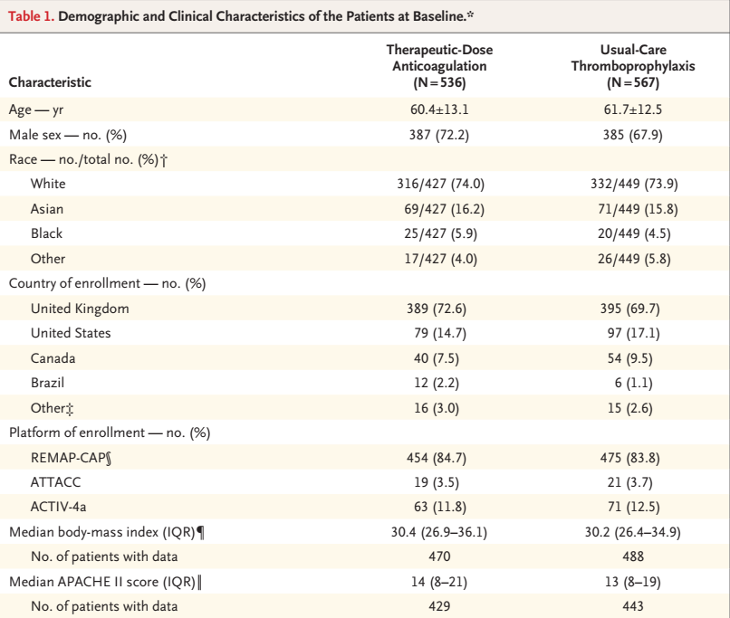

Slide 16
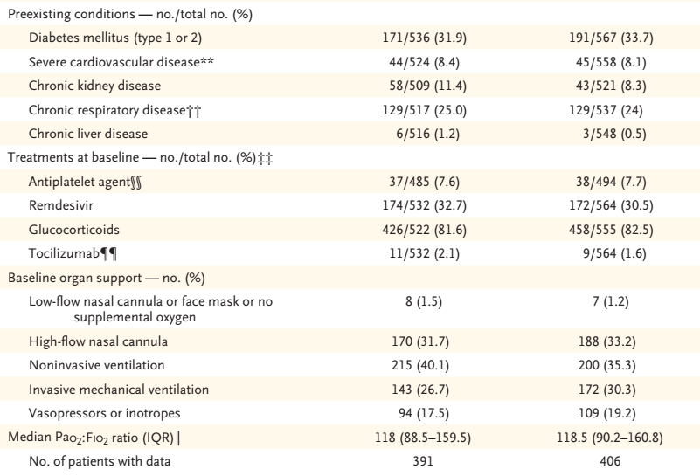

Slide 17
RESULTS
Organ support free days up-to day 21-
Therapeutic dose anticoagulation- Median =1
Thromboprophylaxis- Median=4
With high Probability of inferiority(95%) and futility(99%) with therapeutic dose anticoagulation.
Survival to hospital discharge
Therapeutic dose anticoagulation- 335/534(62.7%)
Thromboprophylaxis- 364/564(64.5%)
With high Probability of inferiority(89.2%) and futility(99.6%) with therapeutic dose anticoagulation.

Slide 18
SAFETY OUTCOME RESULTS
Thrombotic events:
Therapeutic dose anticoagulation: 6.4%
Thromboprophylaxis: 10.4%
Bleeding events:
Therapeutic dose anticoagulation: 3.8%
Thromboprophylaxis: 2.3%

Slide 19
Primary and Secondary Outcomes

Slide 25
COMPARISON DATA
 | Critically ill therapeutic anticoagulation (n=534) | Critically ill thromboprophylaxis(n=564) | Non critically ill therapeutic anticoagulation (n=1171) | Non critically ill thromboprophylaxis (n=1048)
Median value for organ support free days | 1 | 4 | 22 | 22
% of patients surviving discharge | 62.7% | 64.5% | 80.2% | 76.4%
Major bleeding | 3.8% | 2.3% | 1.9% | 0.9%
Thrombotic events | 6.4% | 10.4% | 8% | 9.9%

Slide 26
DISCUSSION
Randomized trial involving more than 1000 critically ill patients with confirmed COVID-19,
Therapeutic-dose anticoagulation did not increase the probability of survival to hospital discharge or the number of days free of cardiovascular or respiratory organ support
95% probability of being inferior to usual- care pharmacologic thromboprophylaxis.
Routine therapeutic-dose anticoagulation doesn’t appear to benefit critically ill patients with COVID-19.

Slide 27
DISCUSSION
The net effect of anticoagulation on clinical outcomes in patients with COVID-19 may depend on the timing of initiation in relation to disease course
The result obtained in the trial may be due to the fact that therapeutic anticoagulation may not be efficient in advanced disease process where it may add up to complications more than benefit due to well formed fibrin clots not amenable to treatment.
Therapeutic-dose anticoagulation might exacerbate alveolar haemorrhage, leading to worse outcomes as was seen in autopsy.

Slide 28
LIMITATION
Open-label design, which may have introduced bias in the ascertainment of thrombotic events.
Substantial majority of the patients who were enrolled in the severe- disease cohort were in the United Kingdom, where national practice guidelines changed during the trial for anticoagulation.
22.4% patients didn’t receive the actual therapeutic dose whereas 51.7% patients in the thromboprophylaxis group received intermediate dose- this factor may have diluted the benefit of therapeutic dose anticoagulation.

Slide 29
CONCLUSION
In critically ill patients with COVID-19:
Therapeutic-dose anticoagulation with unfractionated or low-molecular weight heparin was not associated with:
1) A greater probability of survival to hospital discharge
2) or a greater number of days free of cardiovascular or respiratory organ support than was usual-care pharmacologic thromboprophylaxis.

Slide 30
THANK YOU

