Slide 1
Safety and immunogenicity of seven COVID-19 vaccines as a third dose (booster) following two doses of ChAdOx1 nCov-19 or BNT162b2 in the UK (COV-BOOST): a blinded, multicentre, randomized, controlled, phase 2 trial
Dr Aishwarya Malode
PG Resident of Medicine
SMS Medical College, Jaipur (Rajasthan)

Slide 2
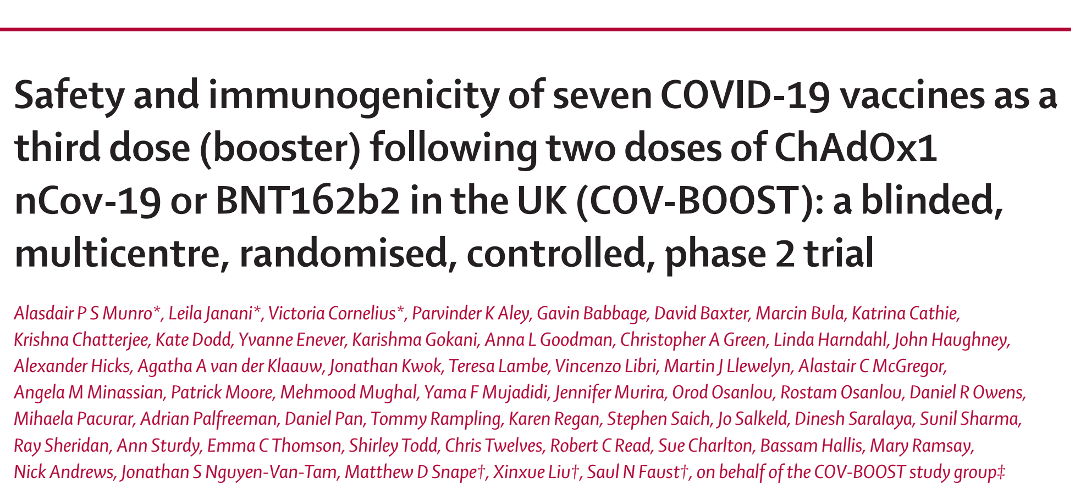
Lancet Neurol 2021; 20: 275–83
Lancet 2021; 398: 2258–76

Slide 3
Introduction
After two doses of ChAdOx1-S or BNT162b2 vaccine, there is waning in vaccine effectiveness in terms of hospitalization and death at 20 weeks or more after vaccination.
Waning is greater in older adults and in those in high-risk group.
Hence, the need for this study.
Duration of Protection against Mild and Severe Disease by Covid-19 Vaccines

Slide 4
Vaccines used in COV–boost trial
Vaccine | Manufacturer | Mechanism of action | Dose administration
ChAdOx-nCov19 (ChAd; AZD1222 | AstraZeneca | Replication-deficient chimpanzee adenovirus vectored vaccine,expressing the SARS-CoV-2 spike surface glycoprotein | 5 × 10¹⁰ viral particles per 0·5 mL via intramuscular injection
NVX-CoV2373 (NVX; Novavax) | Novavax | Nanoparticle vaccine containing purified spike glycoprotein | 5 μg with Matrix-M1 50 μg adjuvant in 0·5 mL via intramuscular injection
BNT162b2 (BNT; Pfizer–BioNTech) | Pfizer–BioNTech | mRNA vaccine encoding SARS-CoV-2 spike glycoprotein | 30 μg in 0·3 mL via intramuscular injection
VLA2001 (VLA; Valneva) | Valneva | Whole, inactivated SARS-CoV-2 virus | 33 antigen units with 1 mg CpG adjuvant in 0·5 mL via intramuscular injection
Ad26.COV2.S (Ad26; Janssen) | Janssen | Replication-deficient adenovirus vector vaccine constructed to encode a full-length spike protein | 5 × 10¹⁰ viral particles per mL in 0·5 mL via intramuscular injection
mRNA1273 (m1273; Moderna) | Moderna | Replication-deficient adenovirus vector vaccine constructed to encode a full-length spike protein | 100 μg administered via 0·5 mL via intramuscular injection
a

Slide 5
Objectives
To determine the safety and reactogenicity of annual booster doses.
To determine whether the immune response to booster immunization with different COVID-19 vaccines is superior to control vaccination for participants who have received priming vaccination with either ChAdOx1-nCov19 or BNT162b2
Further characterization of immunogenicity of booster vaccination against ancestral and novel variants of SARS-CoV-2

Slide 6
Trial design
Three stage, randomized, adaptive phase II multi-centre study of annual booster vaccination against ancestral and novel variants of SARS-CoV-2.
Analyzing statisticians, Participants and laboratory staff was blind to treatment allocation.

Slide 7
Participant criteria
Male or Female, aged 30 years or above and in good health as determined by a trial clinician. Participants may have well controlled or mild-moderate comorbidity
Received priming dose of COVID-19 vaccination at least 84 days post second vaccination
Prime-boosted with their second dose of Supplementary AstraZeneca with a minimum of 70 days from their second dose.
4

Slide 8
Material & Methods

Slide 10
Group A received: Ratio - 1:1:1:1
NVX-CoV2373 (Novavax; Ref. as NVX),
A half dose of NVX,
ChAd,
Quadrivalent meningococcal conjugate vaccine (MenACWY) control

Slide 11
Group B received: Ratio - 1:1:1:1
BNT, VLA2001 (Valneva; Ref. as VLA),
A half dose of VLA, Ad26.
COV2.S (Janssen; Ref. as Ad26)
MenACWY

Slide 12
Group C received: Ratio - 1:1:1:1
mRNA1273 (Moderna; Ref. as m1273),
CVnCov (CureVac; Ref. as CVn),
A half dose of BNT,
MenACWY

Slide 13
Follow up
Participants attended screening and vaccination at day 0. Blood taken for immunogenicity at days 28, 84 and 365.
A subgroup of 25 from each group (n=650) had blood taken at day 7 and day 14
Solicited AEs on day 7, unsolicited AEs on day 28, and medically attended AEs on day 84 were recorded.

Slide 14
Outcomes - The coprimary outcomes
Safety and reactogenicity were determined by the occurrence of AEs following vaccination.
Immunogenicity outcome was anti-spike protein IgG at day 28 follow-up.

Slide 15
Outcomes
The secondary outcomes
Anti-spike immunoglobulins | Day 0, 7*, 28, 84, 365
Neutralising antibodies against SARS-CoV-2 | Day 0, 28, 84, 365
Pseudo neutralising antibodies | Day 0, 28, 84, 365
Cellular immune responses by ELISpot* | Day 0, 14*, 28, 84, 365

Slide 16
Statistical analysis
Safety and Reactogenicity
Expressed as Counts and percentages of each solicited adverse reaction
Unsolicited AEs and SAEs presented by groups of vaccine received.
Immunogenicity
The geometric mean concentrations (GMC) of anti-spike IgG compared between each of the vaccine arms and the Men ACWY arm within each cohort.
Linear regression with site as a fixed effect was used

Slide 17
Baseline characteristics of groups
Characteristics | ChAd/ChAd primed | BNT/BNT primed
Median age (younger) | 53 | 51
Median age (older) | 76 | 78
Female | 676 (46.7%) | 770 (53.6%)
White population | 1380 (95.4%) | 1321 (91.9%)

Slide 18
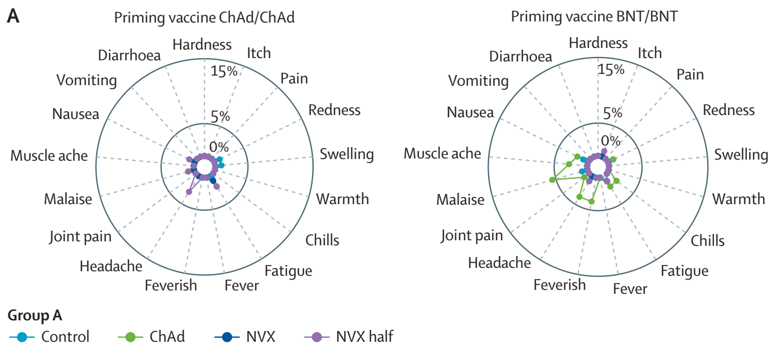
Reactogenicity analysis

Slide 19
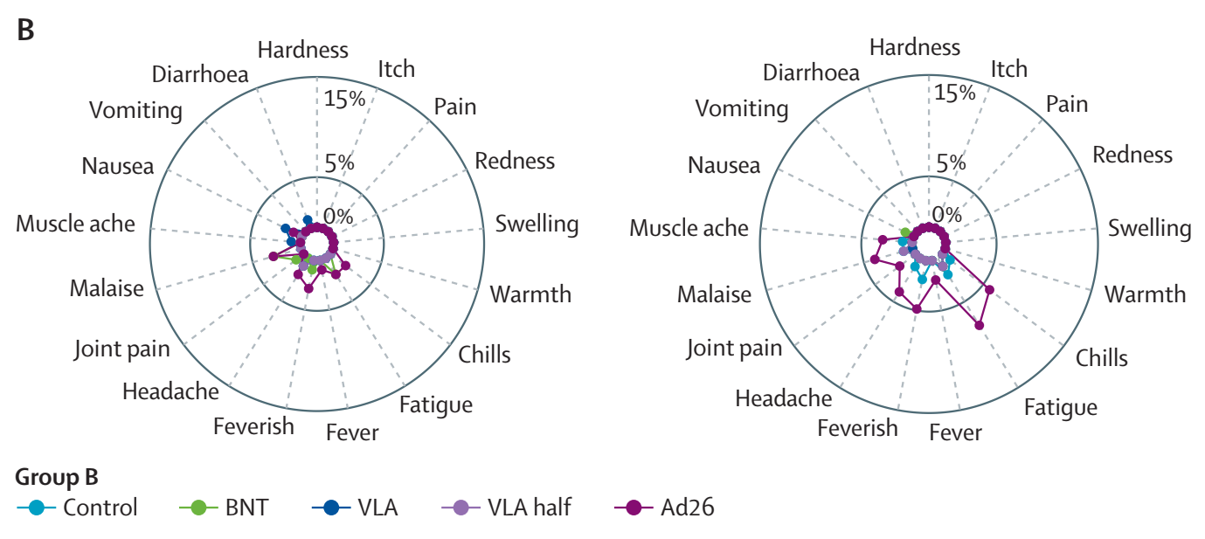
Reactogenicity analysis

Slide 20
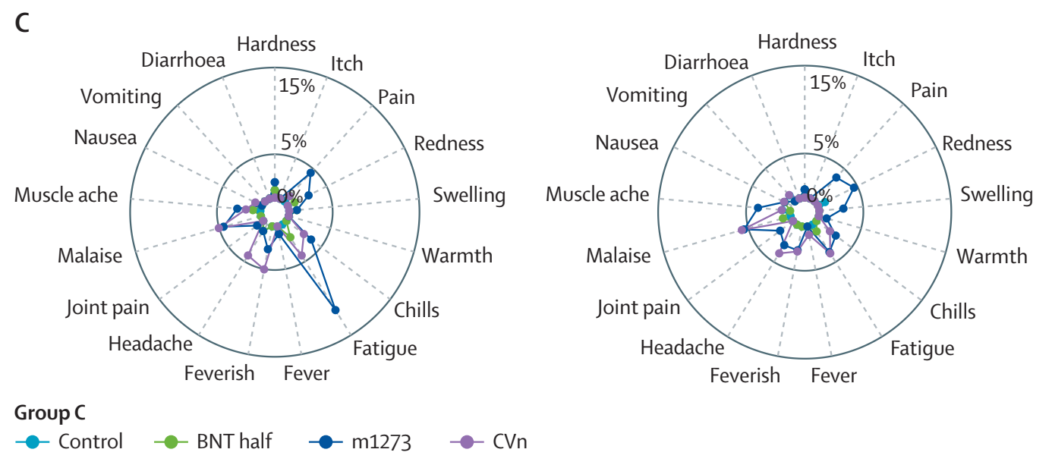
Reactogenicity analysis

Slide 21
Geometric mean in vaccines with age in AstraZeneca primed group

Slide 22
Cellular response with age in AstraZeneca primed group

Slide 23
Geometric mean in vaccines with age in Pfizer primed group

Slide 24
Cellular response with age in Pfizer primed group

Slide 25
Immune responses by third dose vaccine allocation and priming vaccine schedule at 28 days post boost dose among the COVID-19-naive modified intention-to-treat population, group A

Slide 26
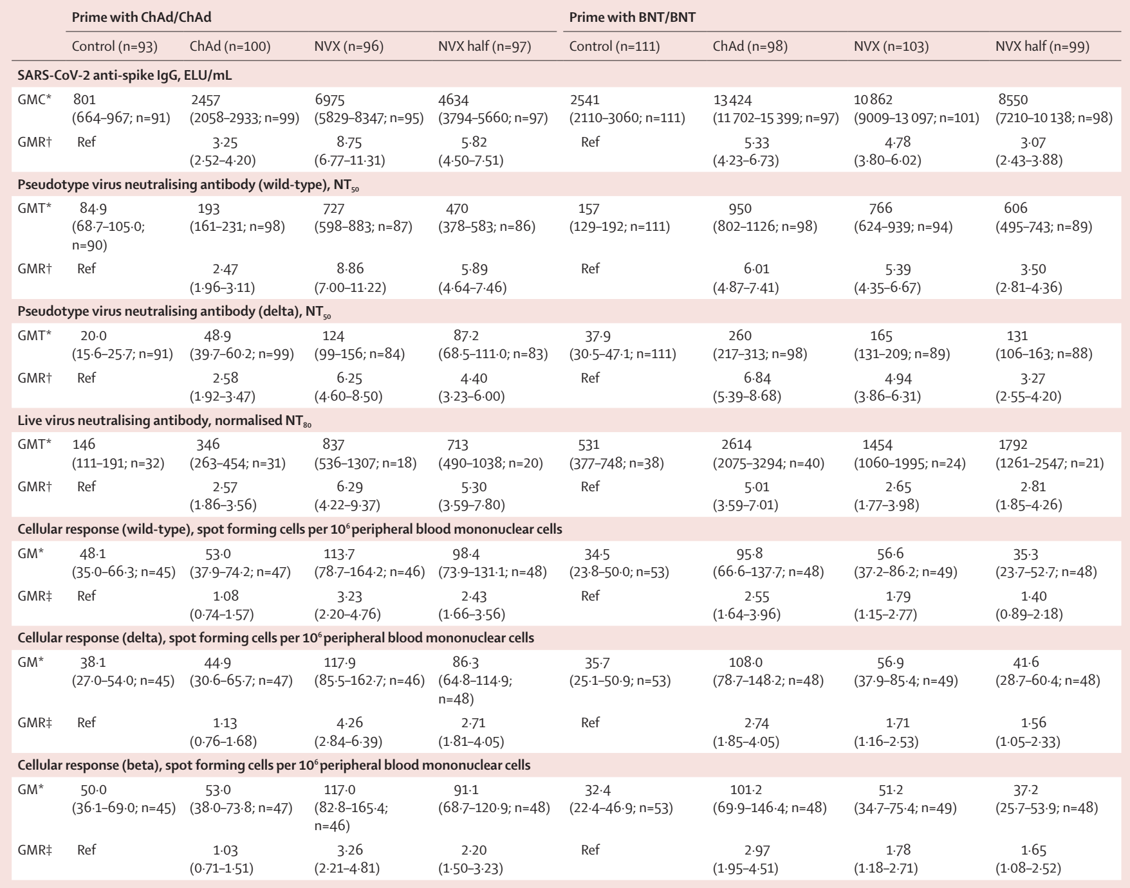

Slide 27
Immune responses by third dose vaccine allocation and priming vaccine schedule at 28 days post boost dose among the COVID-19-naive modified intention-to-treat population, group B

Slide 28
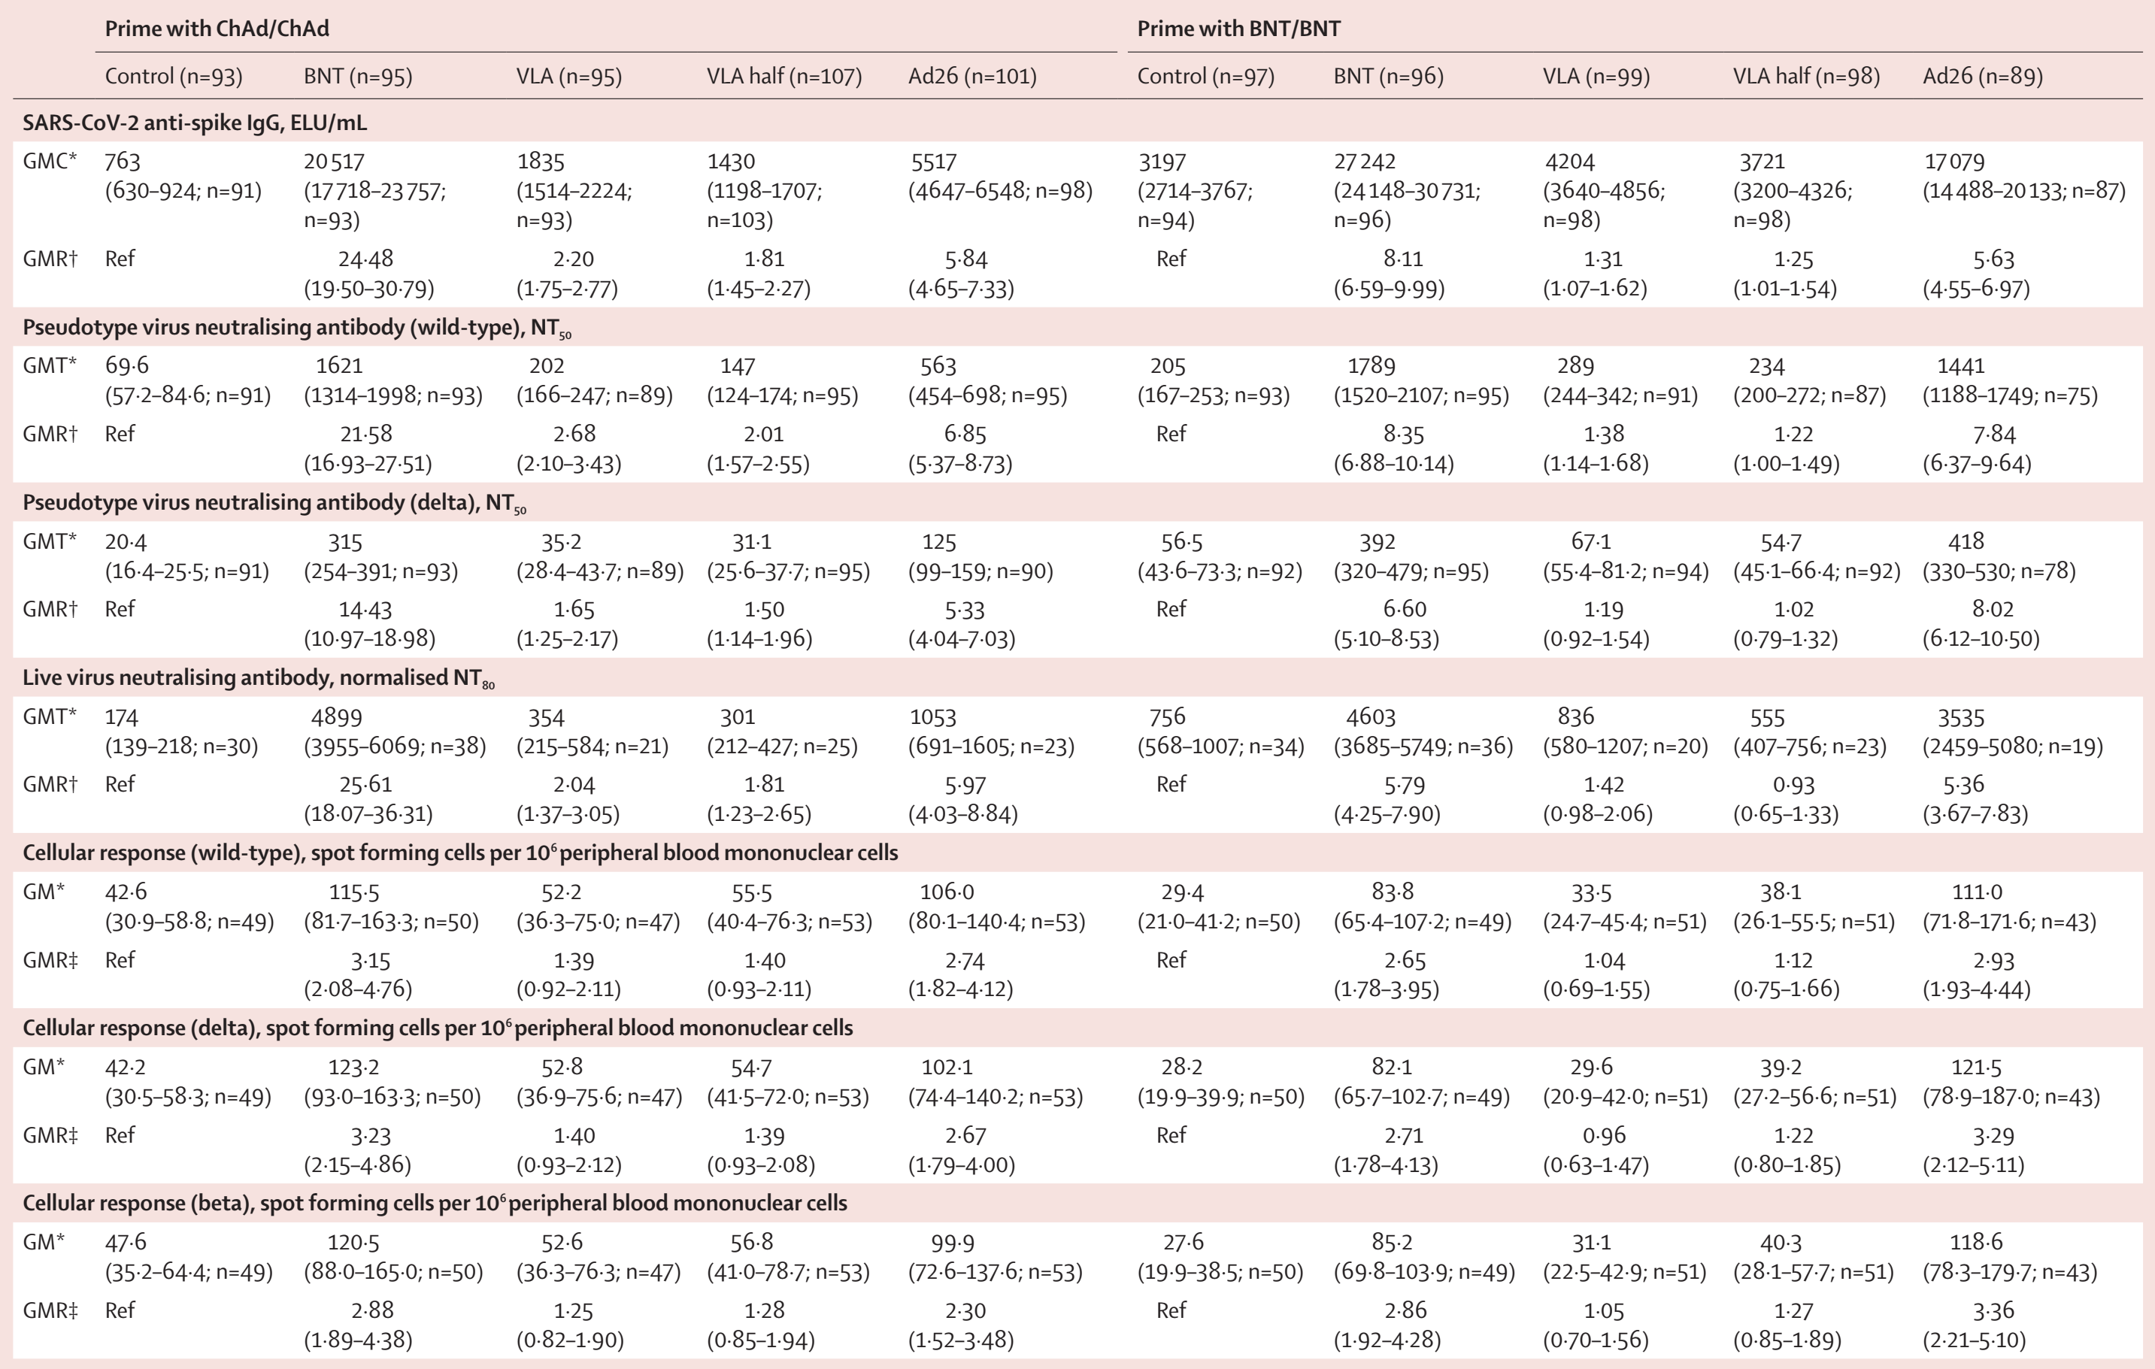

Slide 29
Immune responses by third dose vaccine allocation and priming vaccine schedule at 28 days post boost dose among the COVID-19-naive modified intention-to-treat population, group C

Slide 30
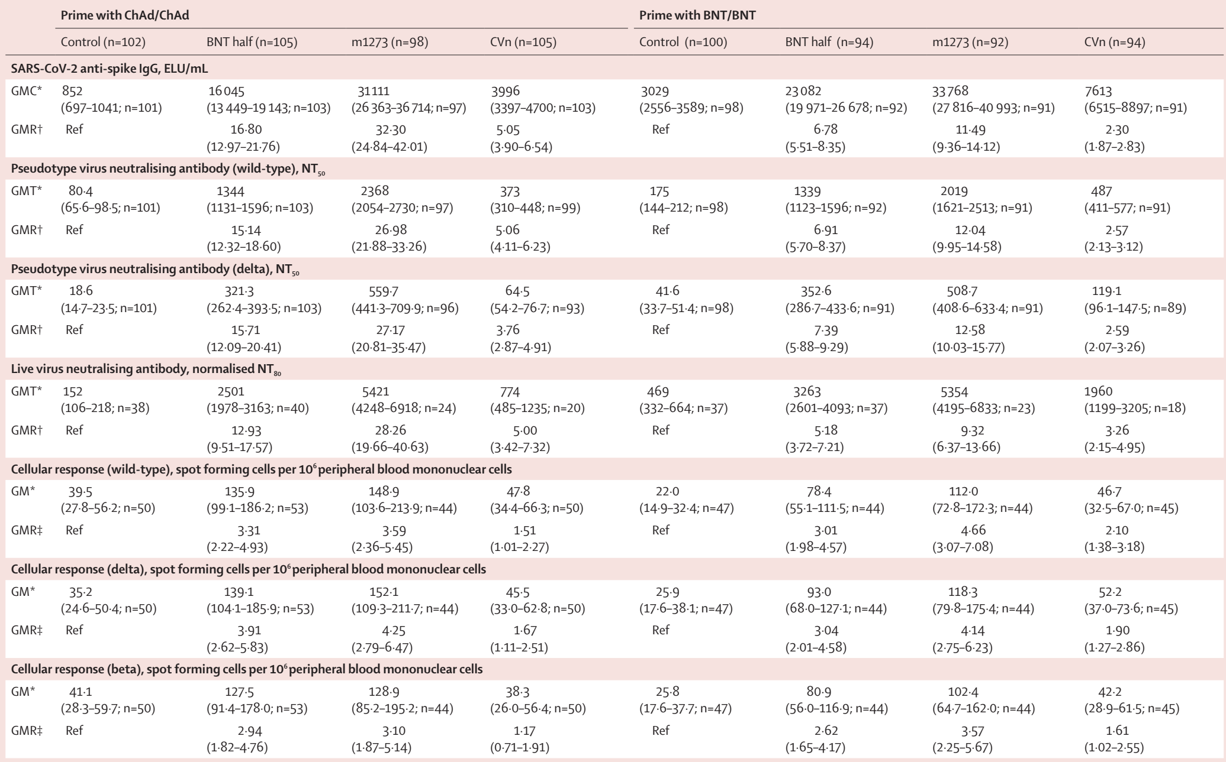

Slide 31
Discussion
All COVID 19 vaccines tested showed acceptable reactogenicity
Vaccine combinations showing higher local and systemic reactogenicity :
ChAd after BNT/BNT in the group aged 30–69 years
m1273 and CVn in all ages for ChAd and ChAd prime
M1273 in the group aged younger than 70 years for BNT/BNT prime
Ad26 after ChAd/ChAd or BNT/BNT in people younger than 70 years

Slide 32
The analysis shows there was good correlation seen for all vaccines between the pseudo-neutralising assay NT50 against the wild-type and delta variants at days 0 and 28
The immunogenicity of homologous or heterologous third dose boost with all tested vaccines was superior to control regardless of which vaccine had been received in the initial course, apart from VLA following BNT/BNT.

Slide 33
Impact of dosing interval
The impact of dose interval remains to be fully elucidated—
There is better reported immunogenicity when a second dose of Ad26 is given at 6 months after the first dose of Ad26 compared with 2 months
Improved antibody responses when the initial BNT doses are spaced by 12 weeks rather than 3 weeks, although cellular response might be lower.
People given initial ChAd doses spaced 3–4 weeks appear to have lower protection against infection than people receiving ChAd/ChAd 16 weeks apart.

Slide 34
Cellular response
mRNA vaccines and Ad26 show increased responses after ChAd/ChAd and BNT/BNT.
ChAd does not boost cellular responses after ChAd/ChAd;8,26. NVX boosts cellular responses better after ChAd/ChAd than BNT/BNT
VLA does not induce any significant cellular responses to spike protein at day 28 compared with control after ChAd/ChAd or BNT/BNT.

Slide 35
Fractional dose of vaccines
Some reduction in systemic effects was demonstrated compared with controls.
There was no apparent reduction in pain by using a half dose.
A minimal decrease on immunogenicity by anti-spike IgG and neutralizing assays
Maximum spike IgG responses were seen at 7 days after the third dose of half BNT, also for full dose BNT and m1273 after ChAd/ChAd or BNT/BNT.

Slide 36
For other vaccines including the low (12 mg) dose CVn mRNA vaccine, an increment was seen from day 7 IgG to day 28 IgG concentrations
Impact of fractional dosing on rare side effects couldn’t be elucidated
Lower fractional dosing for third dose boost could reduce inflammation and possibly rates of myocarditis seen after BNT or m1273 deployment
Of note, m1273 is now approved at 50% dose (50 µg) when used as a homologous third dose.

Slide 37
Limitations of study
Underestimation of boosting GMR due to reduced dosing interval between subsequent doses
Age range limits generalizability to younger age groups which might be particularly relevant secondary to reactogenicity
Most of the participants under consideration were of white race
Inability to test half dose m1273 vaccines.
External laboratories causing limitation for psedo-neutralizing antibody titer against other variants.

Slide 38
Thank you

